Slide 1
SPECKLE REDUCTION AND SEGMENTATION OF MEDICAL IMAGES
By
Abhinav Kumar Kushwaha Alok Ranjan
Roll No. – 07000006 Roll No. - 07000005
B. Tech - IV B. Tech - IV

Slide 2
SPECKLE PATTERN
Random intensity pattern produced by the interference of a set of wave fronts
Speckles have come into prominence since the invention of laser
An illuminated surface acts as a source of secondary spherical waves
At any point in this scattered light field, the light is made up of waves of different path lengths and the resultant wave varies randomly
If light of low coherence is used, a speckle pattern will not be normally observed
Speckle patterns can be observed in polychromatic light.

Slide 3
METHODS USED FOR REMOVAL OF SPECKLE PATTERNS
SRAD Filter
Lee Filter
Frost Filter
PDE Based Filter

Slide 4
SRAD FILTER
Speckle Reducing Anisotropic Diffusion
It is based on minimum mean square error approach.
It not only preserve edges but also enhance edges by diffusion across edges and allowing diffusion on either side of the edge.
SRAD is adaptive and does not utilize hard thresholds to alter performance in homogeneous regions or in regions near edges and small features.

Slide 5
FROST FILTER
FROST is used primarily to filter speckled SAR data.
Adapts itself to features by using local statistics.
computes a set of weight values for each pixel within the filter window surrounding each pixel.
The damping factor for adaptive filtering (DAMP) depends on the non-filtered image and may require trial-and-error experiments to determine the best value.

Slide 6
LEE FILTER & PDE BASED FILTER
The Lee filter uses a least-squares approach to estimate the true signal strength of the center cell in the filter window from the measured value in that cell.
The Lee filter calculation produces an output value close to the local mean for uniform areas, and a value close to the original input value in higher contrast regions.
In PDE based approach, for removal of noise, the diffusion equation can be written as : ∂I/∂t = ∇.c∇I
Here c is a conductivity coefficient whose makes it possible to make the diffusion adaptive to local image structure

Slide 7
SEGMENTATION
Segmentation refers to the process of partitioning a digital image into multiple segments.
More precisely, image segmentation is the process of assigning a label to every pixel in an image such that pixels with the same label share certain visual characteristics.
Each of the pixels in a region is similar with respect to some characteristic or computed property, such as color, intensity, or texture.
The result of image segmentation is a set of segments that collectively cover the entire image, or a set of contours extracted from the image.

Slide 8
METHODS USED FOR IMAGE SEGMENTATION
Watershed Transformation
Otsu’s Method

Slide 9
WATERSHED TRANSFORMATION
The watershed transformation considers the gradient magnitude of an image as a topographic surface.
Pixels having the highest gradient magnitude intensities (GMIs) correspond to watershed lines, which represent the region boundaries.
Water placed on any pixel enclosed by a common watershed line flows downhill to a common local intensity minimum (LIM).
Pixels draining to a common minimum form a catch basin, which represents a segment.

Slide 10
OTSU’S METHOD
The algorithm assumes that the image to be threshold contains two classes of pixels (e.g. foreground and background)
It then calculates the optimum threshold separating those two classes so that their combined spread (intra-class variance) is minimal.
The extension of the original method to multi-level thresholding is referred to as the Multi Otsu method.

Slide 11
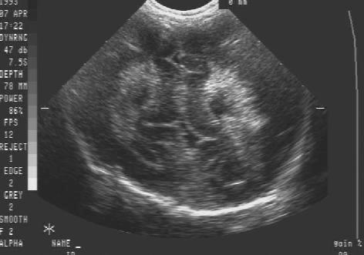

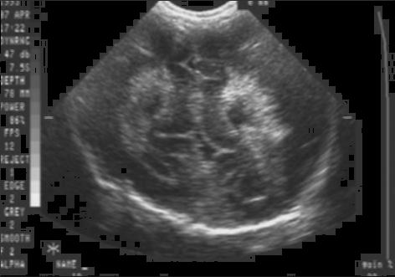


PHOTOS OF SPECKLE REDUCTION
Ultrasound Image with speckle noise
De-noised Images:
SRAD LEE FROST PDE

Slide 12
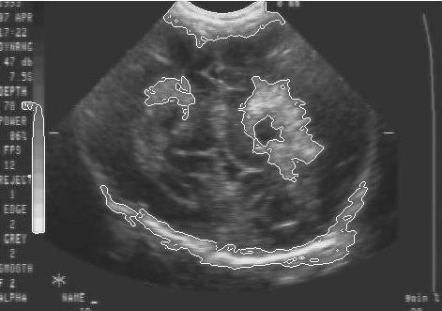
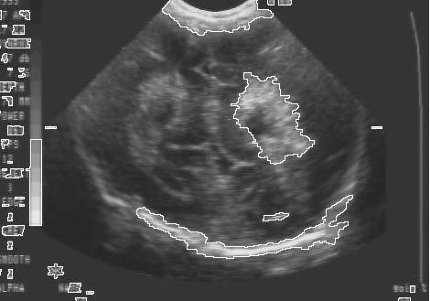
PHOTOS OF SEGMENTATION
De-noised ultrasound image
Images obtained after segmentation:
Otsu’s method Watershed method

Slide 13
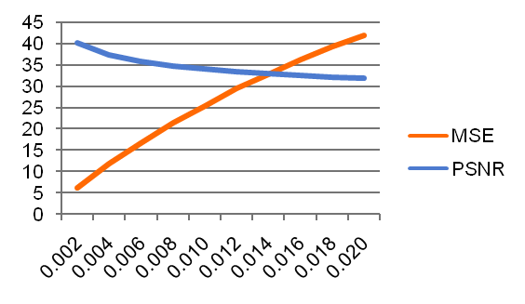
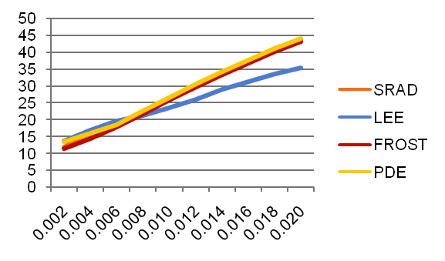
GRAPH OF ALL SPECKLE METHOD
Comparison between original image and noisy image
MSE chat for different algorithms

Slide 14
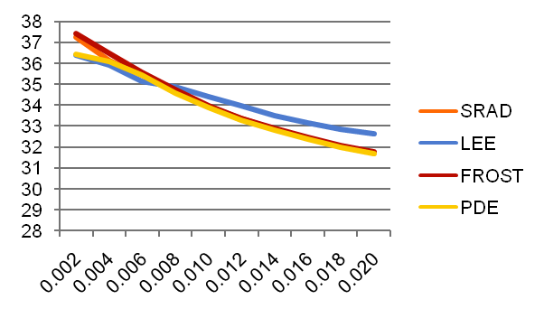
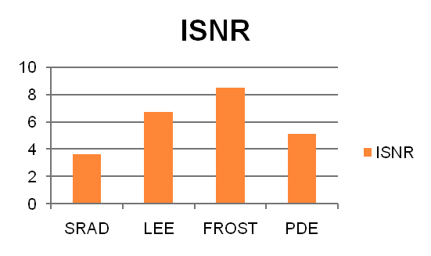
GRAPH OF ALL SPECKLE METHOD (CONTD…)
PSNR chat for different algorithms
Real case scenario:
Input noisy image

Slide 15
CONCLUSION

Slide 16
THANKS

